Slide 1
Material preparation
1. SMT -eero BOM – Indented
2. SMT - eero BOM – Sourcing
3. SMT Build Matrix – (NPI Phase)
4. SMT- CM BOM

Slide 2
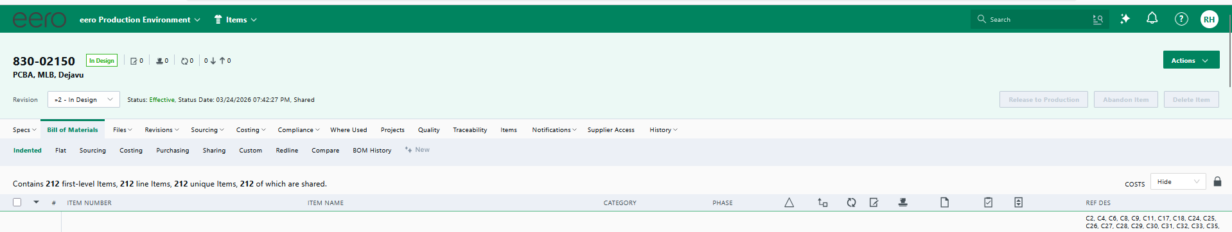
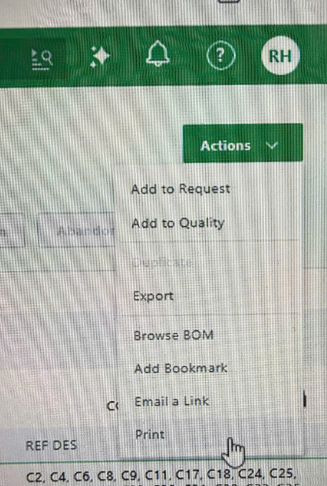
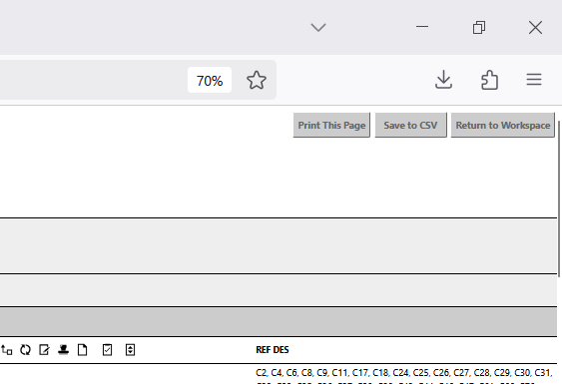
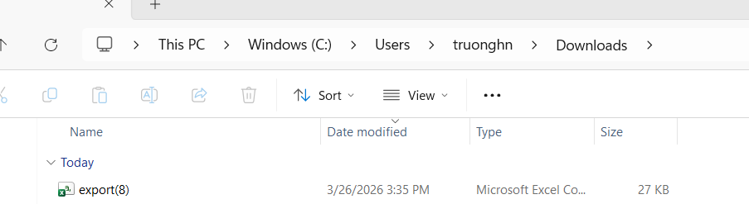
Material preparation
SMT -eero BOM – Indented
Download from Arena.
3
1
2
4
5
6
Rename it to “eero BOM – Indented”

Slide 3
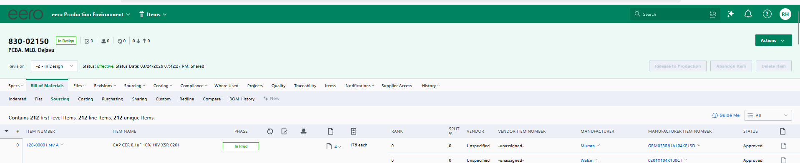
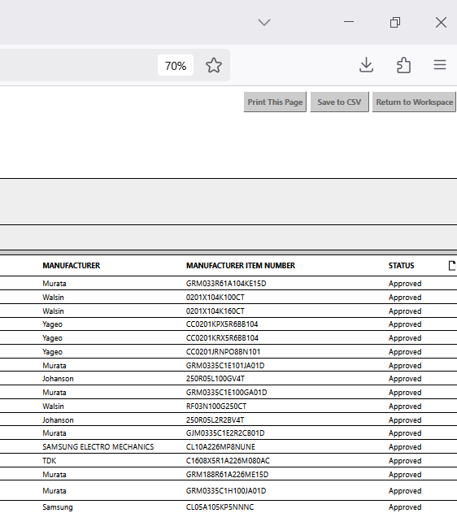
Material preparation
2. SMT - eero BOM – Sourcing
Download from Arena.
3
1
2
5
4
6
Rename it to “eero BOM – Sourcing”

Slide 4
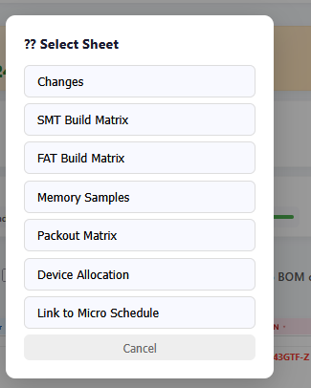
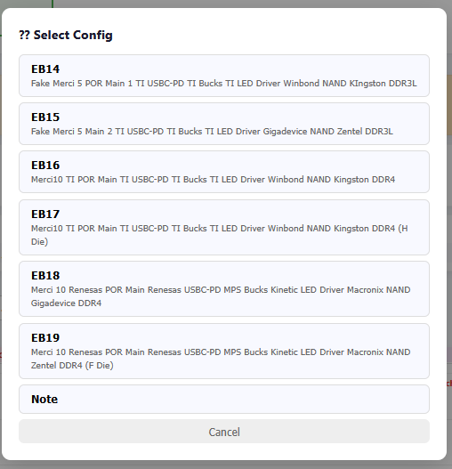
Material preparation
3. SMT - Build Matrix
Download & save it to your PC
. If you want to compare BOM with Config A in the Build Matrix → Please choose the sheet of that Config and choose the Config which you want to compare.
4. SMT - CM BOM
Download & save it to your PC

